Slide 1
Innovator’s
Library
Link to the site
Managing a LIBRARY
made Easy and proficient
Presented By:
Mihir Kumar Badkur(20075108)
Gourav Kumar(20074014)

Slide 2
OBJECTIVE & MOTIVATION
We are planning to create a user-friendly web application that can handle the primary housekeeping functions of a library , making it easier for the libraries to manage asset collections as well as
relationships with their members.
It will help libraries keep track of the books and their checkouts, as well as member’s subscriptions and profiles.
It allows the librarian to maintain library resources in a more operative manner that will help to save their time. It is also convenient for the librarian to manage the process of books allotting and making payment. Library management system is also useful for students as well as a librarian to keep the constant track of the availability of all books in a store.

Slide 3
Why This?
01
02
Hassle-free
Easy-Peasy
04
03
User-Friendly
Clicks are Enough
No need to maintain those cumbersome registers and records
Only, one person is required to take care of the whole system, without any chances of mistakes.
Customer can easily search and find the books.
This system will reduce all the manual work and the whole process can be managed just through single clicks and edits.

Slide 4
Anatomy
We have five tables namely:
Book : Contains the information about all the books.
Book_copy : Information about the number of books available
Users : has the information about the members of library.
Review : Has the rating of books along with the reviewer info.
Feedback : Feedback about the Library of different users.

Slide 5
Structure Of Tables(As We Thought)
Book :
Book_Copy :
id | author | genre | desc | price | rating | img_link
id | borrow_date | book_id | borrower_id | available

Slide 6
Users :
Review :
^{id} | ^{password} | ^{last_login} | ^{is_superuser} | ^{username} | ^{first_name} | ^{last_name} | ^{email} | ^{is_staff} | ^{is_active} | ^{date_joined}
^{id} | ^{rating} | ^{book_reviewed_id} | ^{reviewer_id}

Slide 7
Feedback :
^{id} | ^{name} | ^{mobile_no} | ^{email} | ^{comment} | ^{book_requirement}

Slide 8
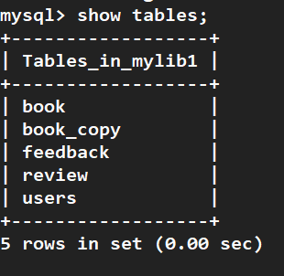
Glimpses
Of Our Database
(Implemented)

Slide 9
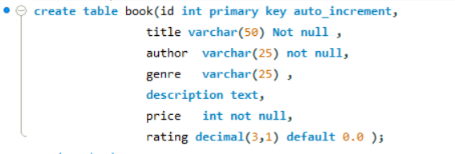
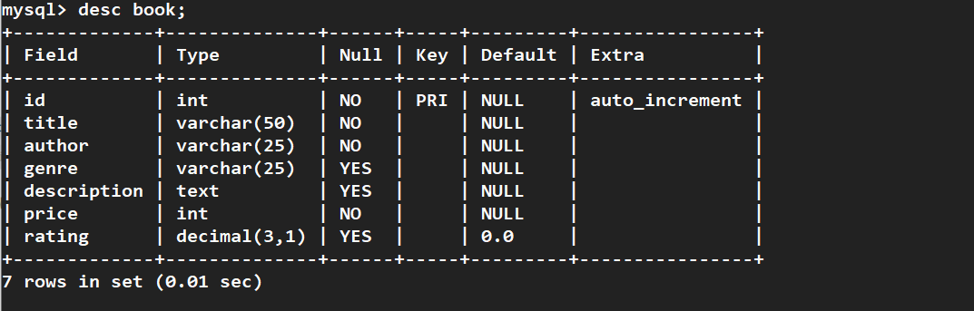
Book
Table

Slide 10
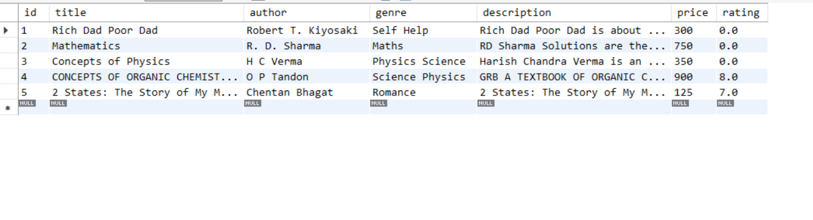
Book
Table

Slide 11
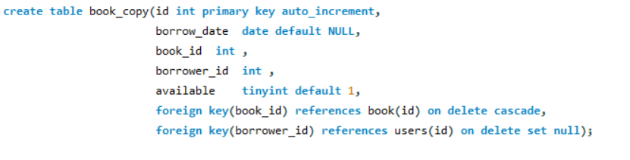
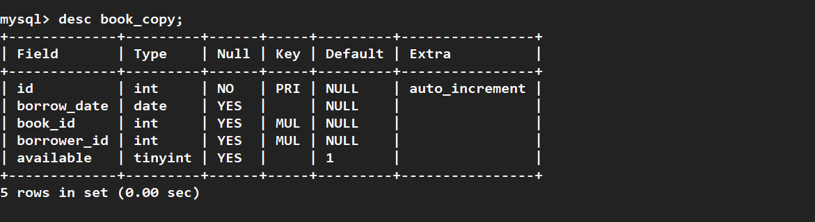
Book_Copy
Table

Slide 12
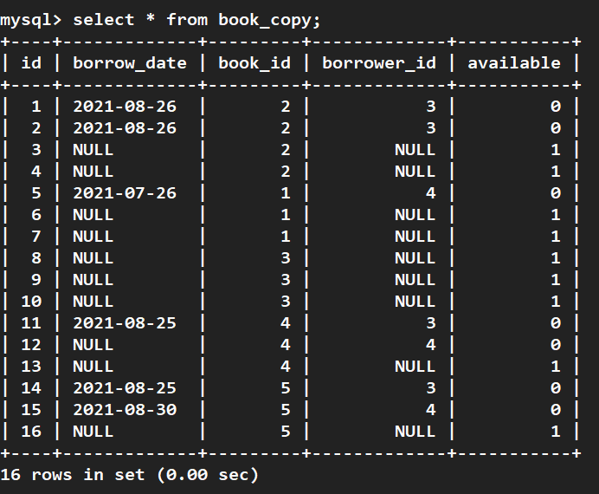
Book_Copy
Table

Slide 13
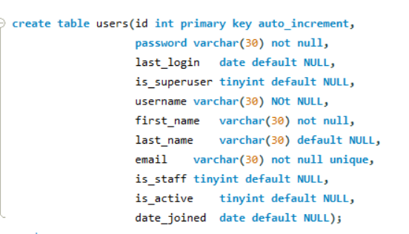
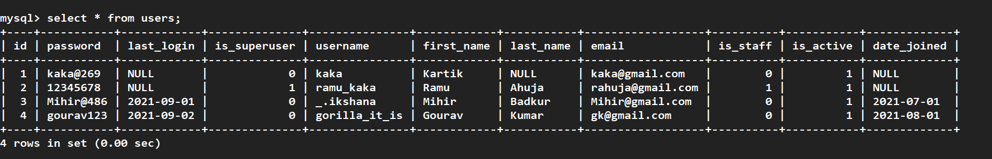
Users
table

Slide 14
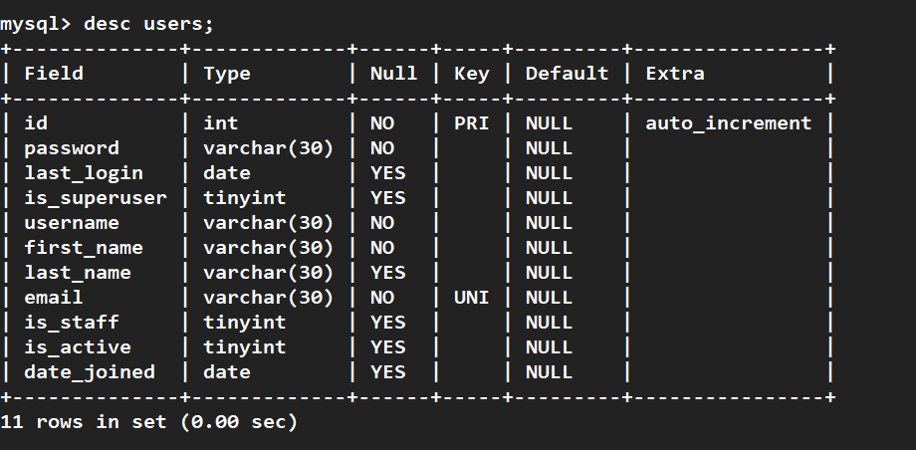
Users
table

Slide 15
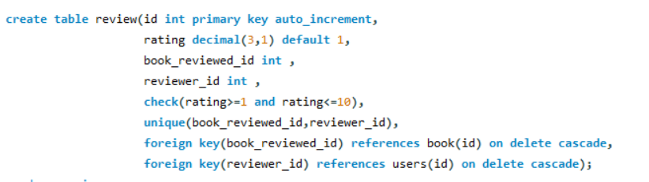
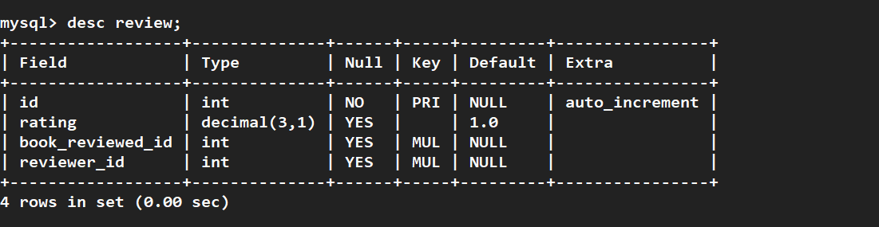
Review
Table

Slide 16
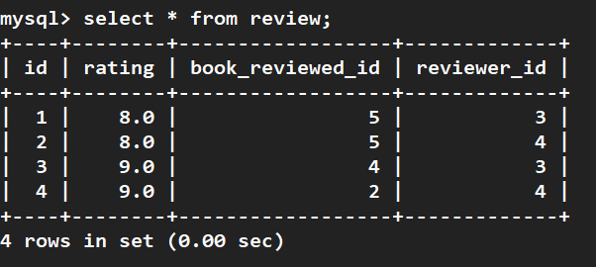
Review
Table

Slide 17
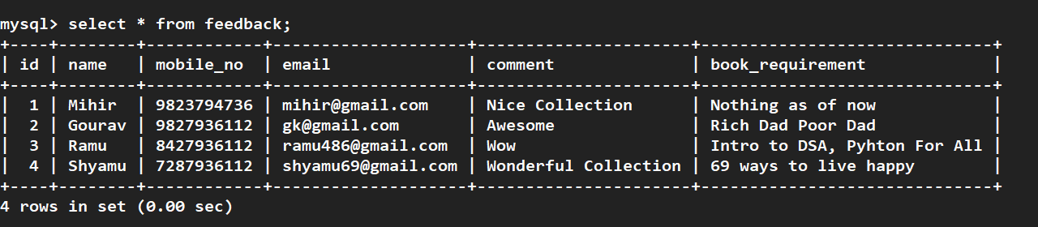
Review
Table

Slide 18
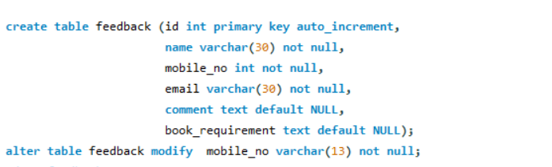
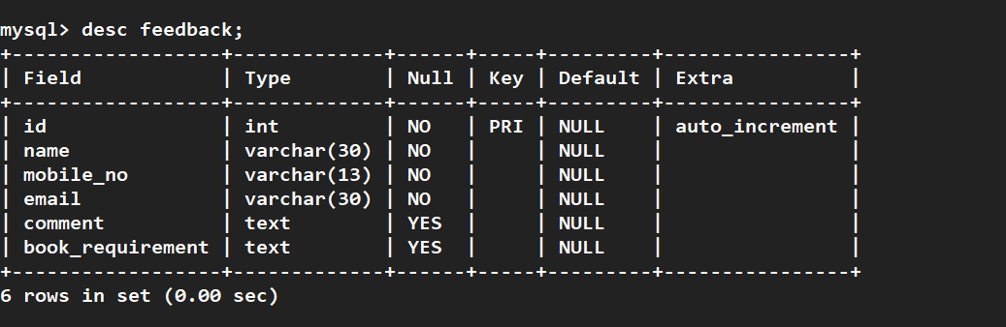
Feedback
Table

Slide 19
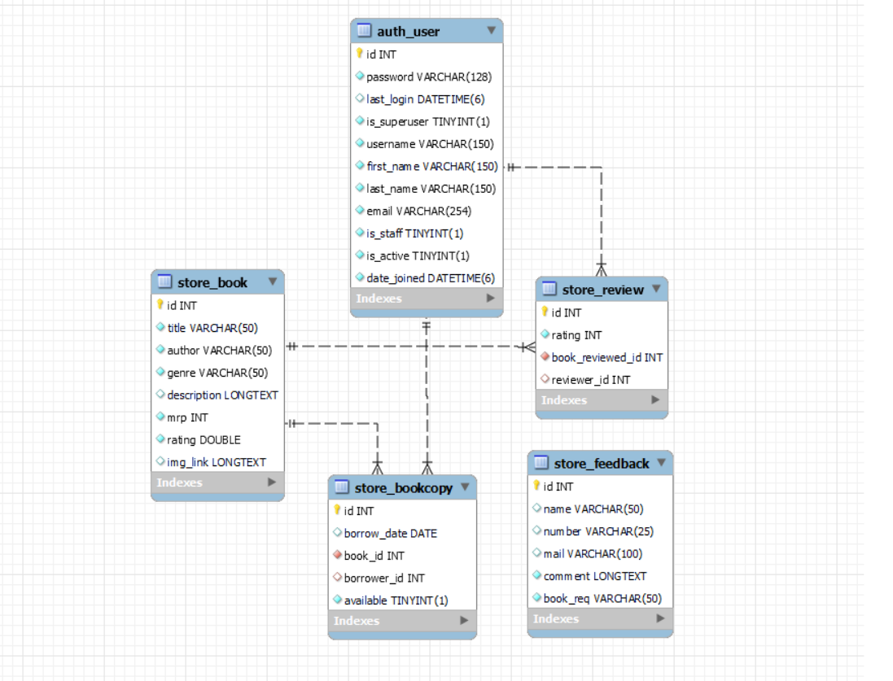
ER Diagram

Slide 20
Timeline
Link to the site
SQL
Back-End
Made the schema and added relations
Will use Django for the backend processing
August
September
October
November
Front-End
Final-Shot
HTML,CSS and JS for frontend
Deployment

Slide 21






Languages & Frameworks Used

Slide 22
How It Looks Like
Link to the site

Slide 23
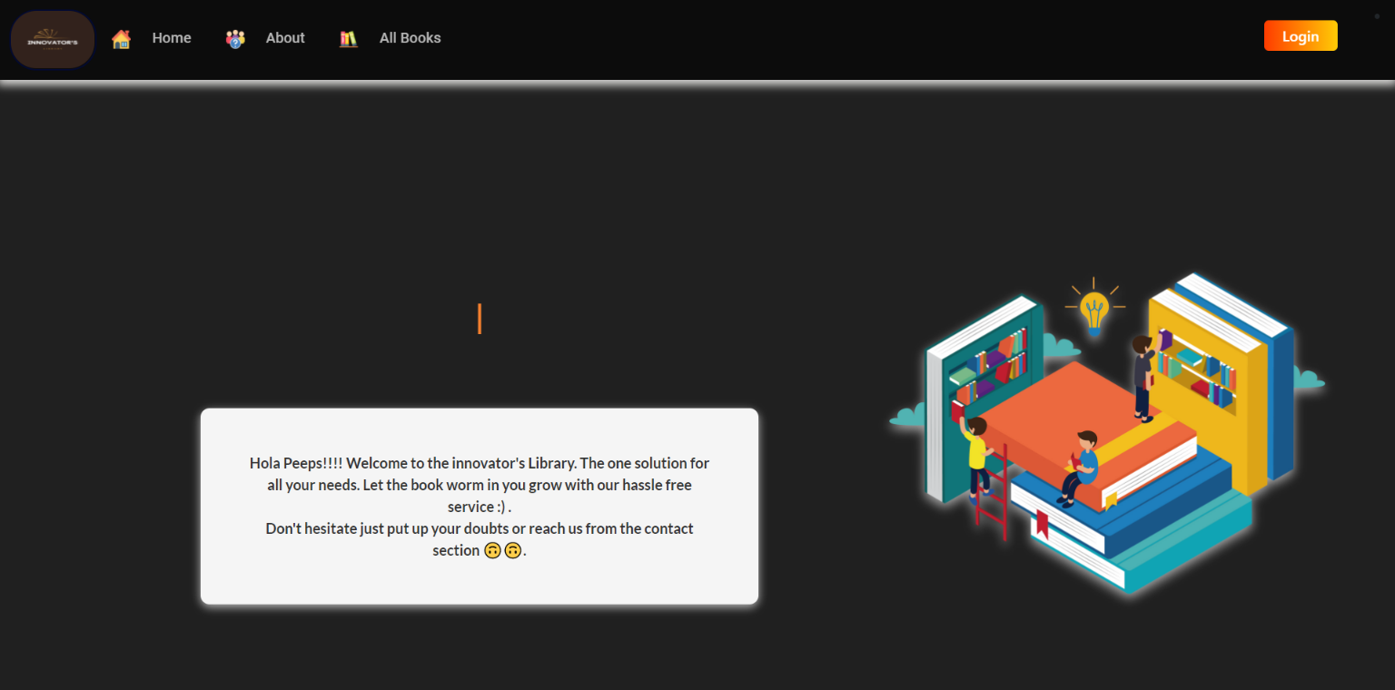
The Homepage

Slide 24
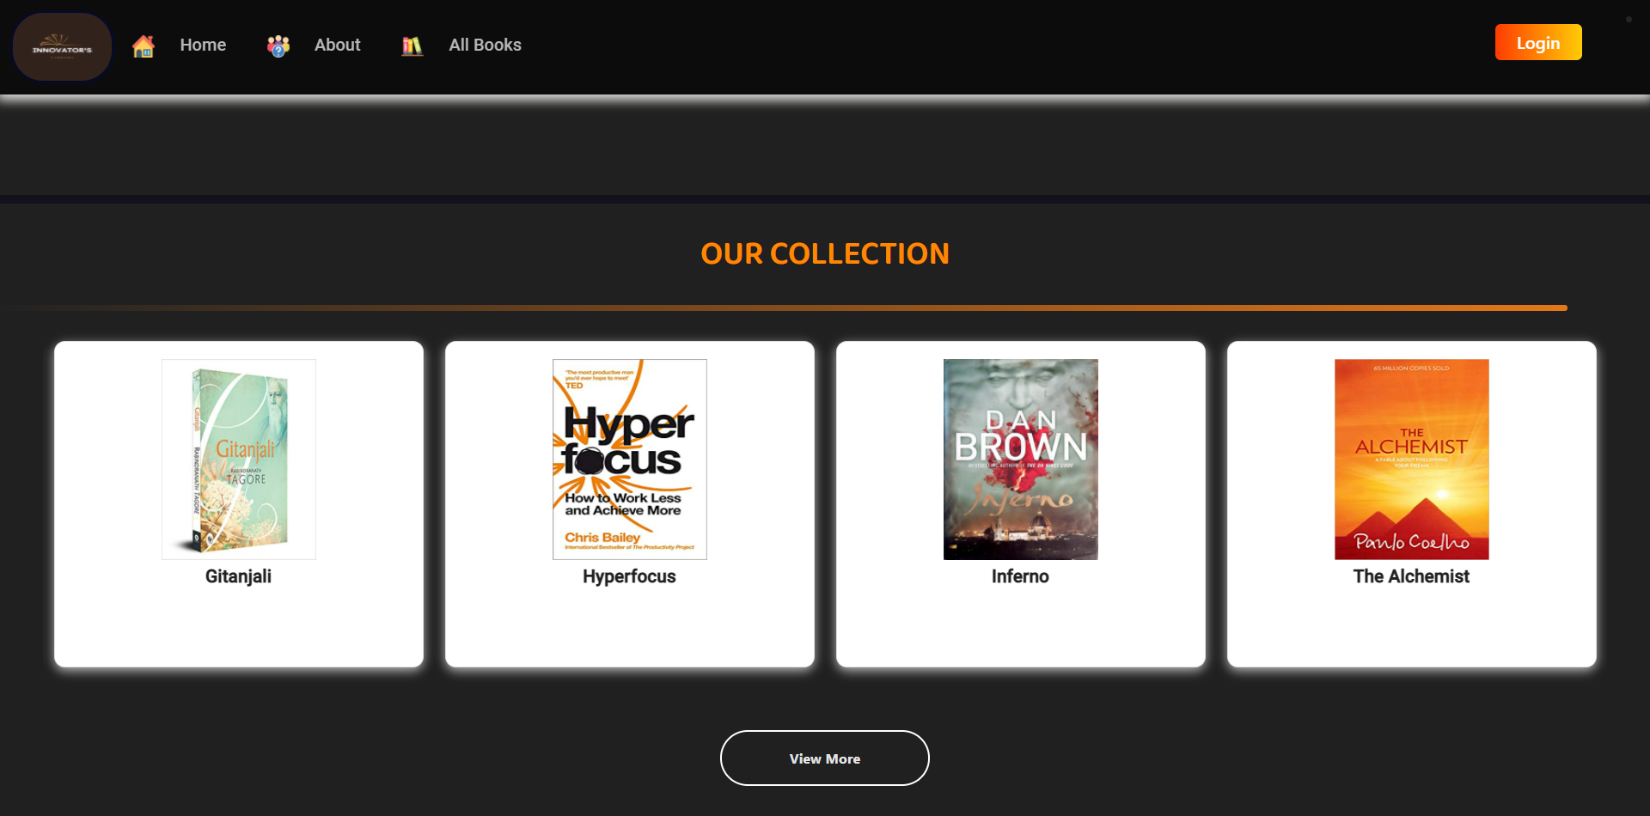
The Homepage(contd.)

Slide 25
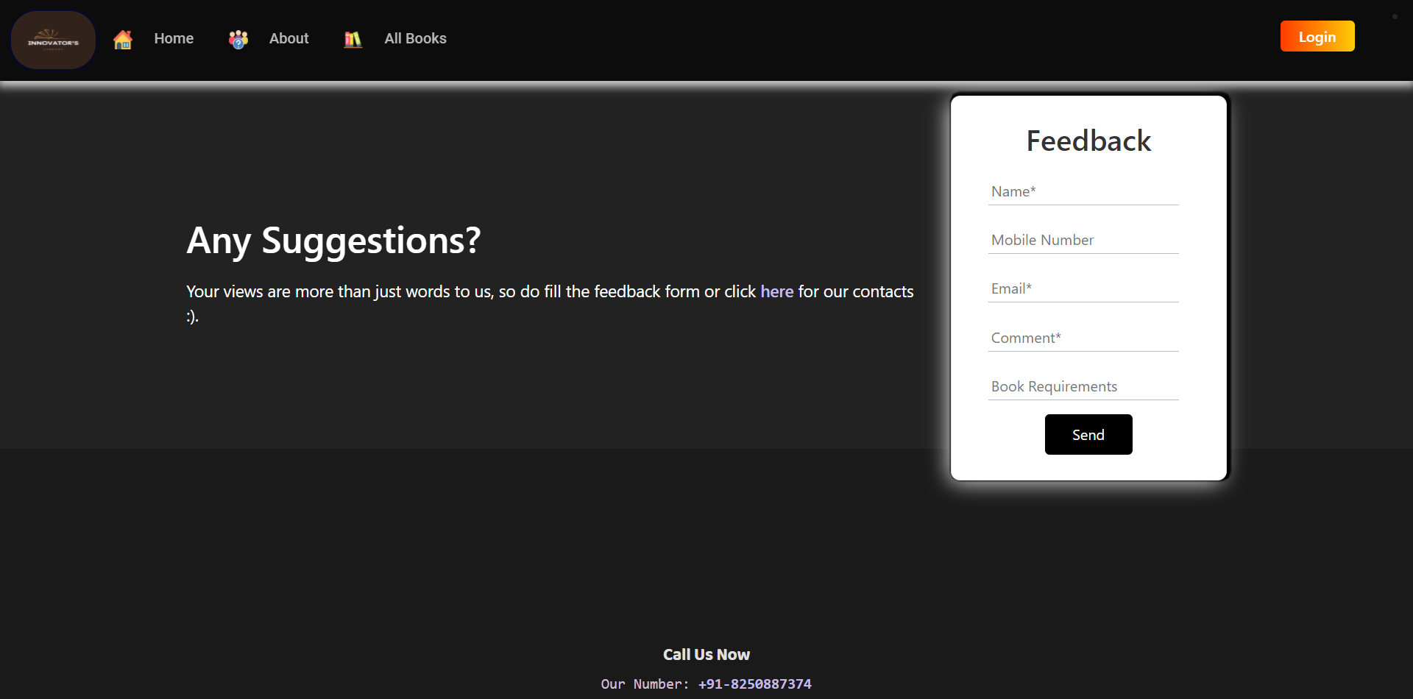
The Homepage(contd.)

Slide 26
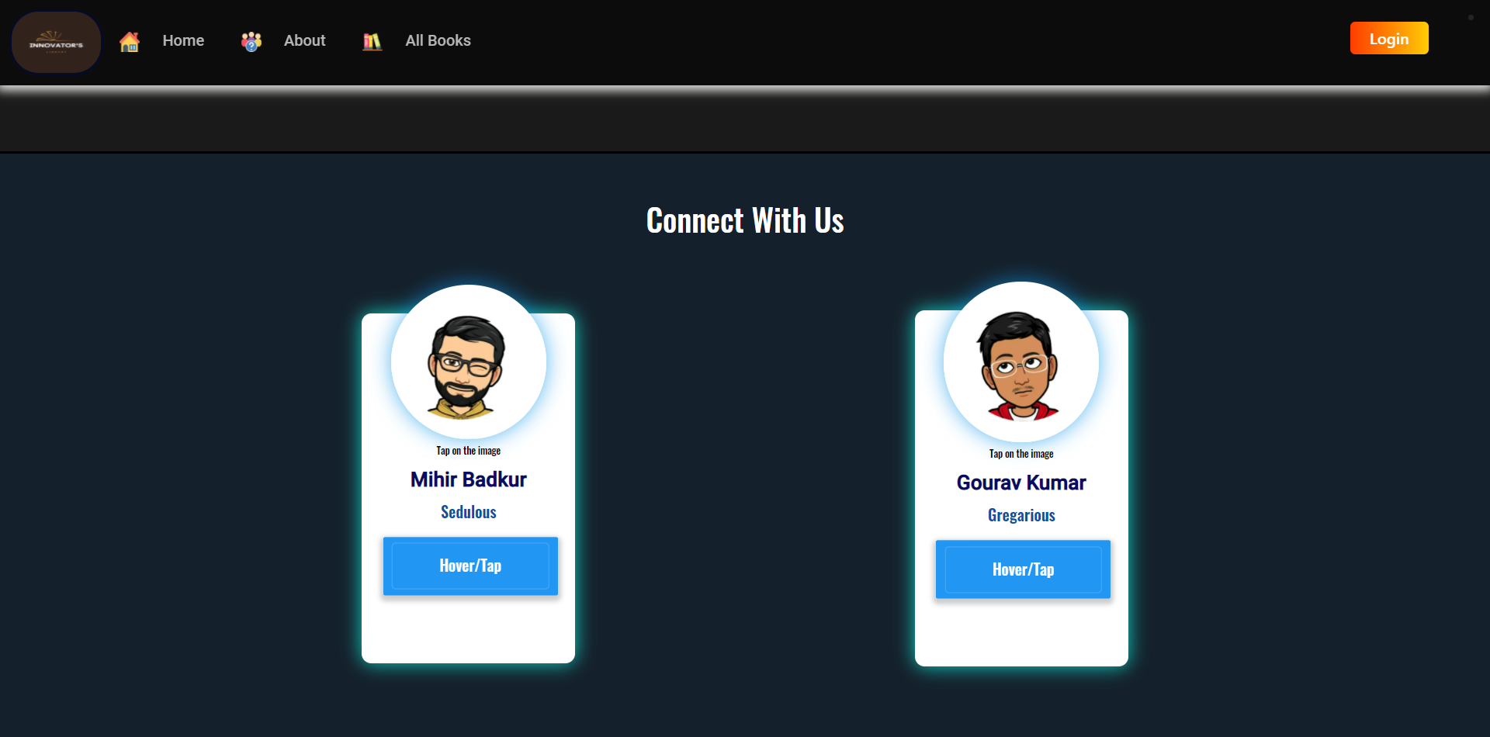
The Homepage(contd.)

Slide 27
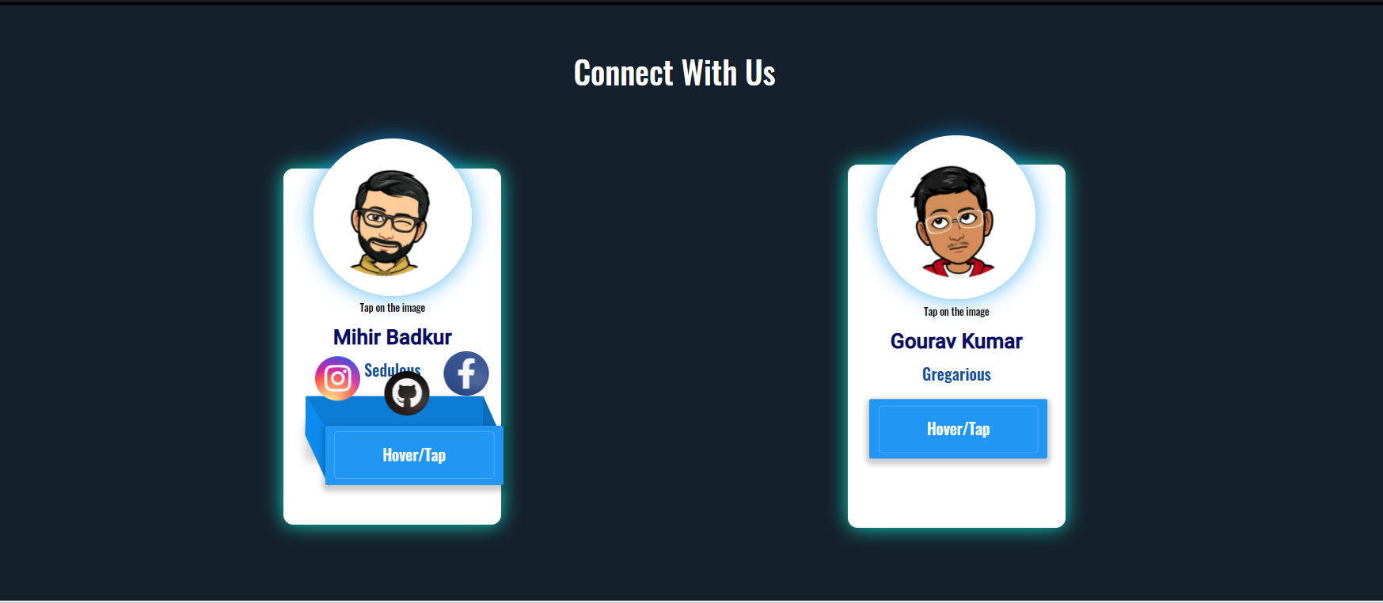
The Homepage(contd.)
“On hover”

Slide 28
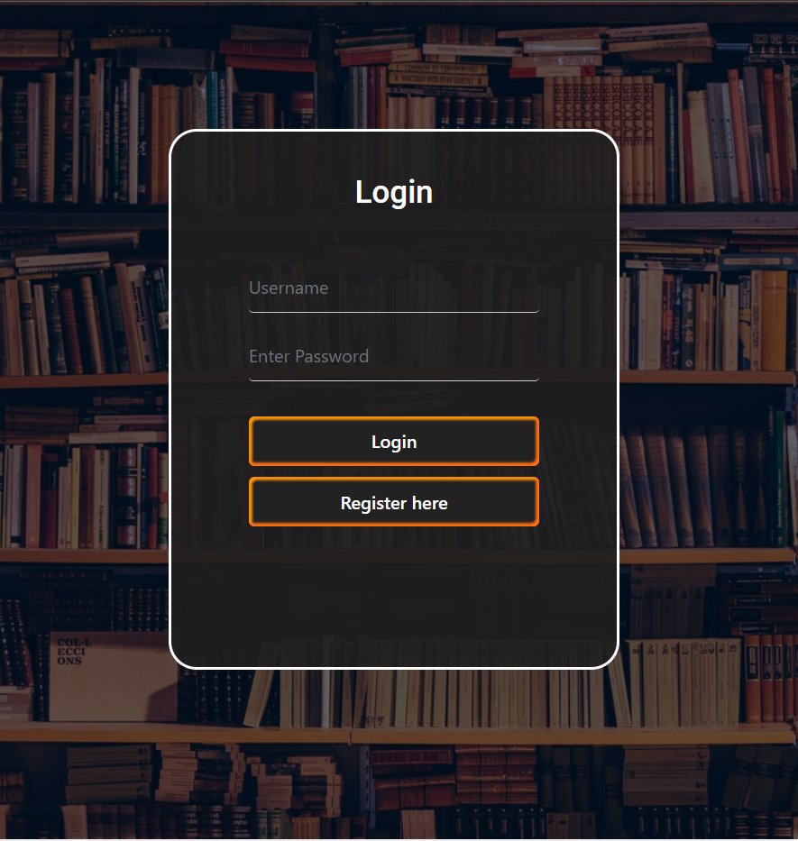
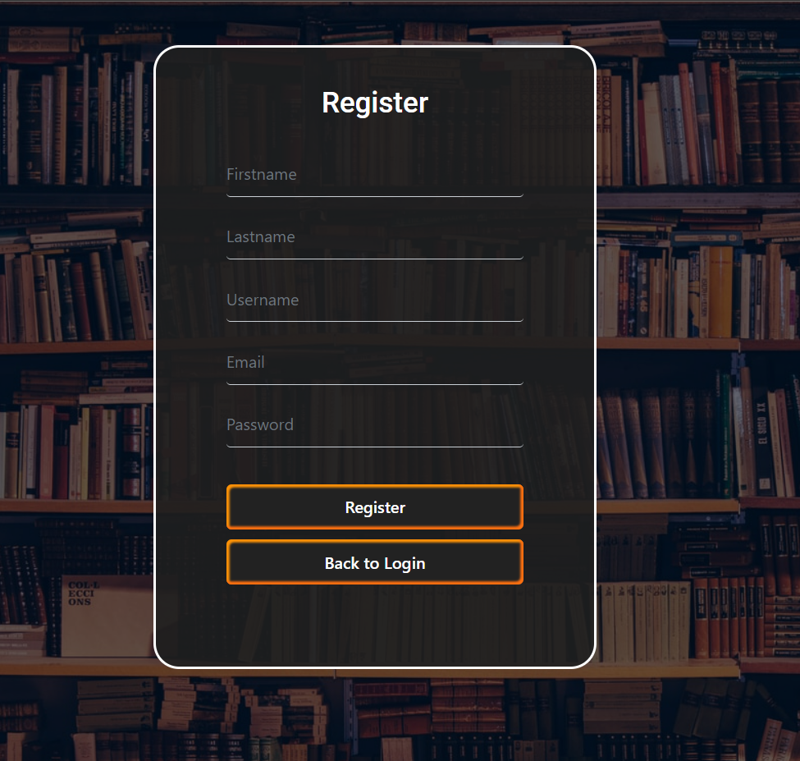
Login/Register

Slide 29
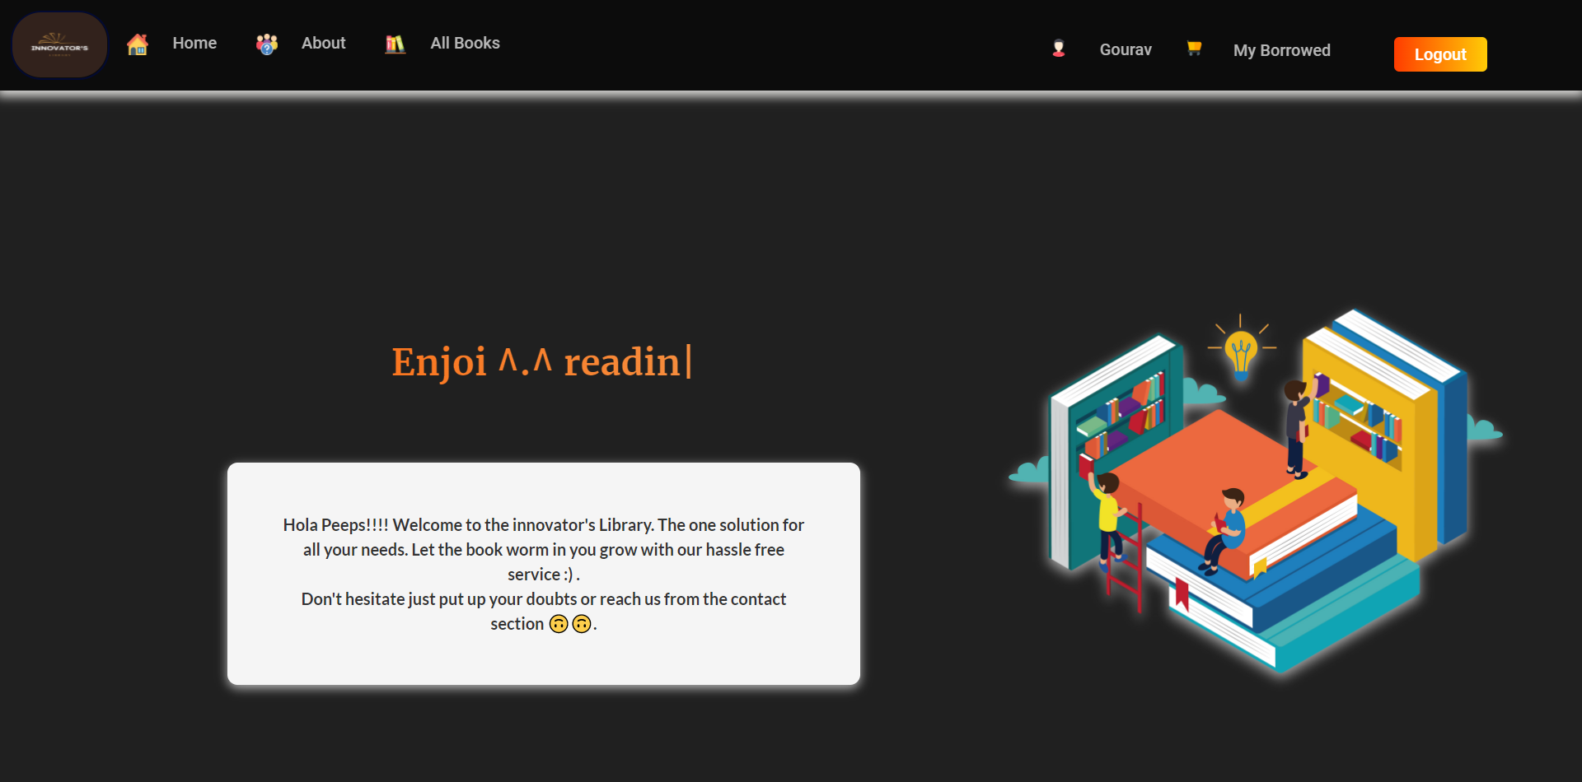
The Homepage(contd.)
“After Login”

Slide 30
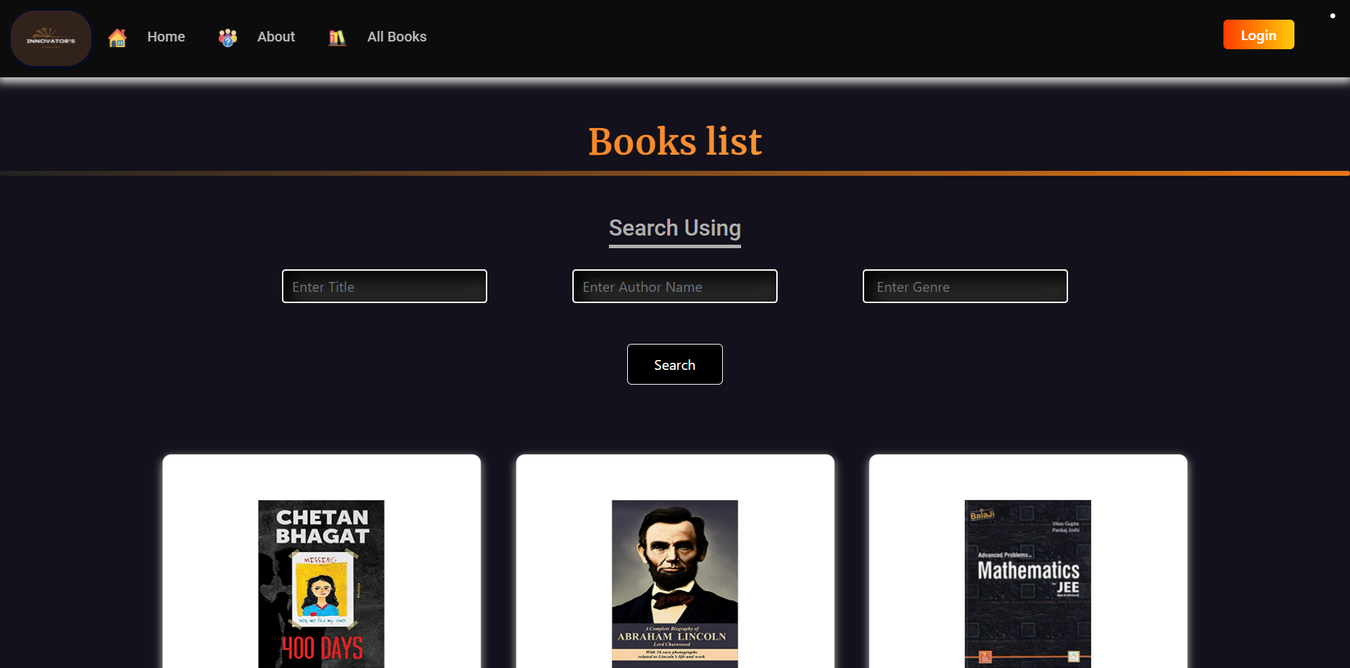
All Books Page

Slide 31
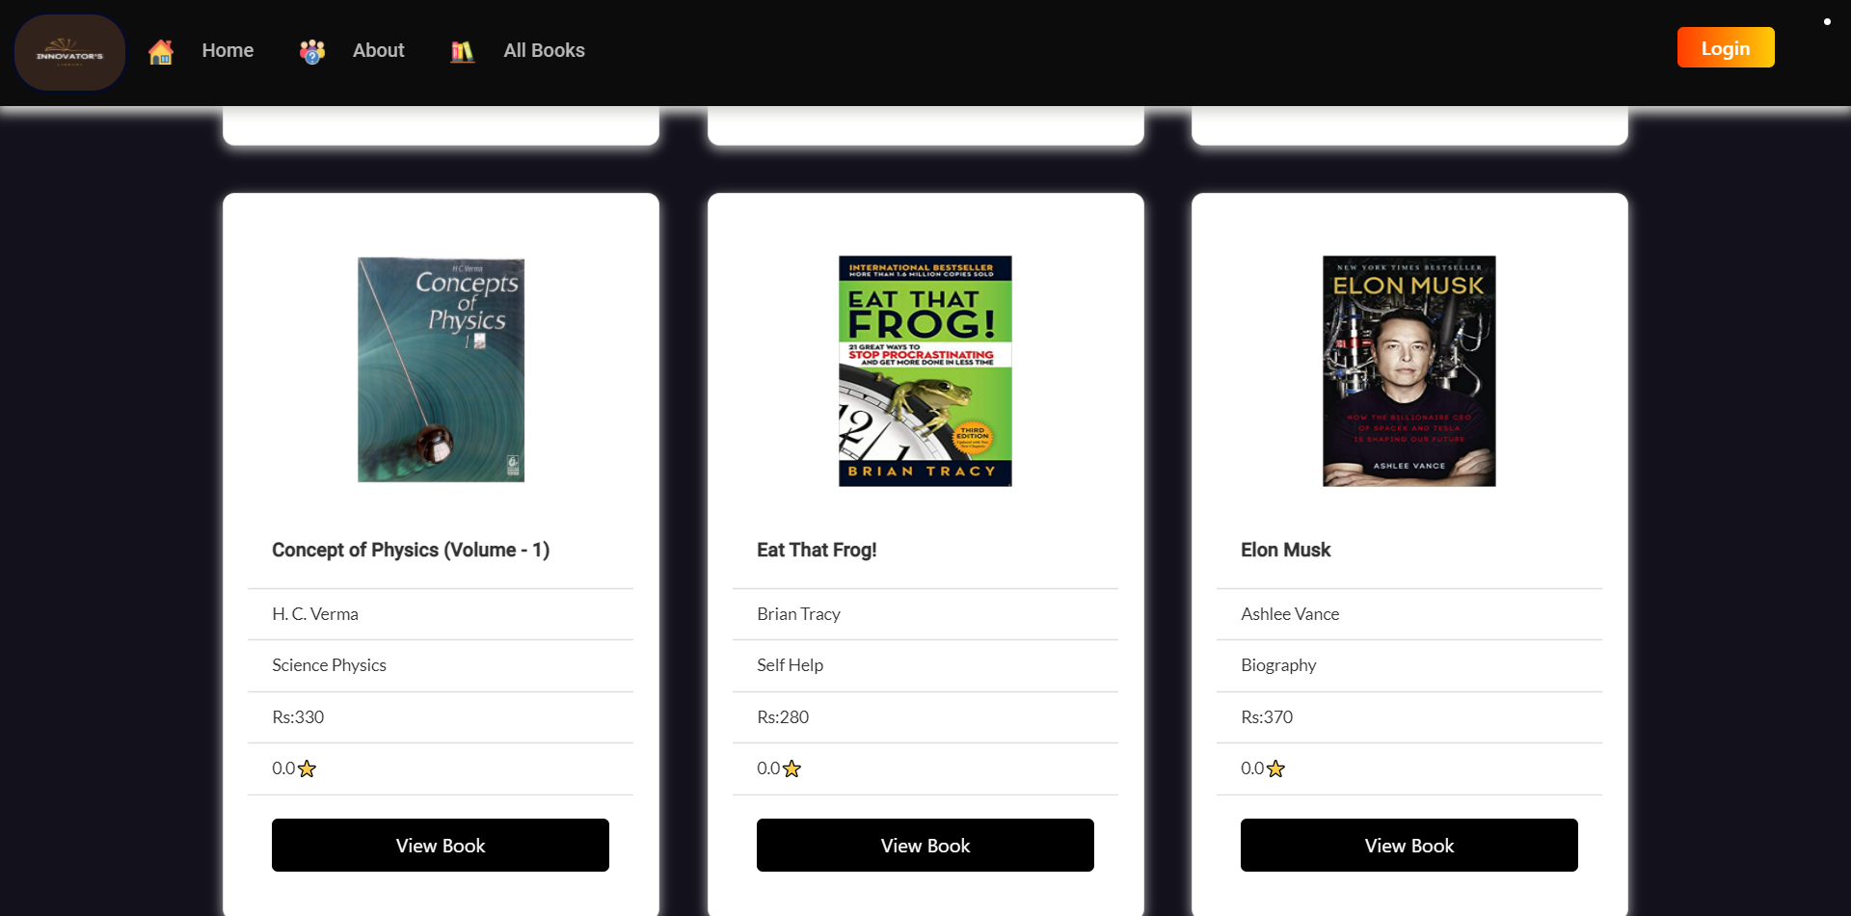
All Books Page(contd.)

Slide 32
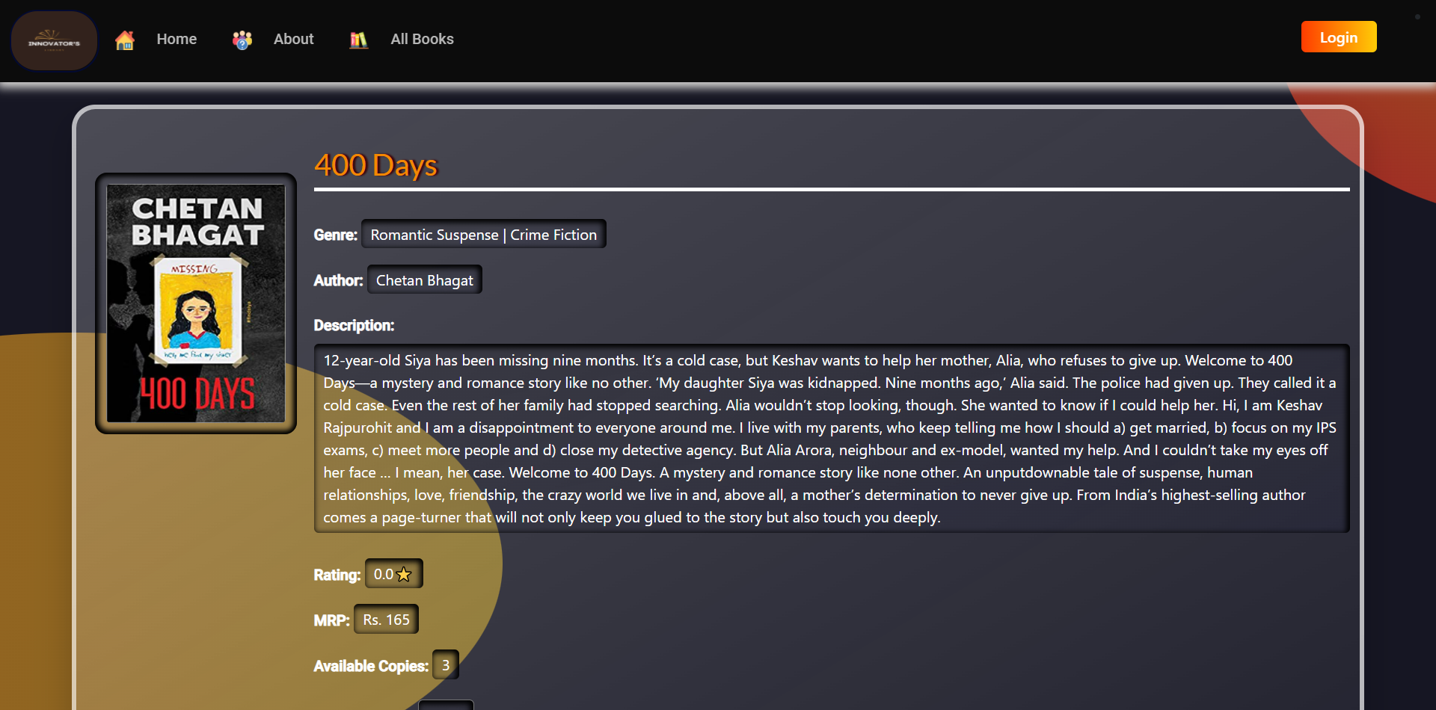
Book Detail Page

Slide 33
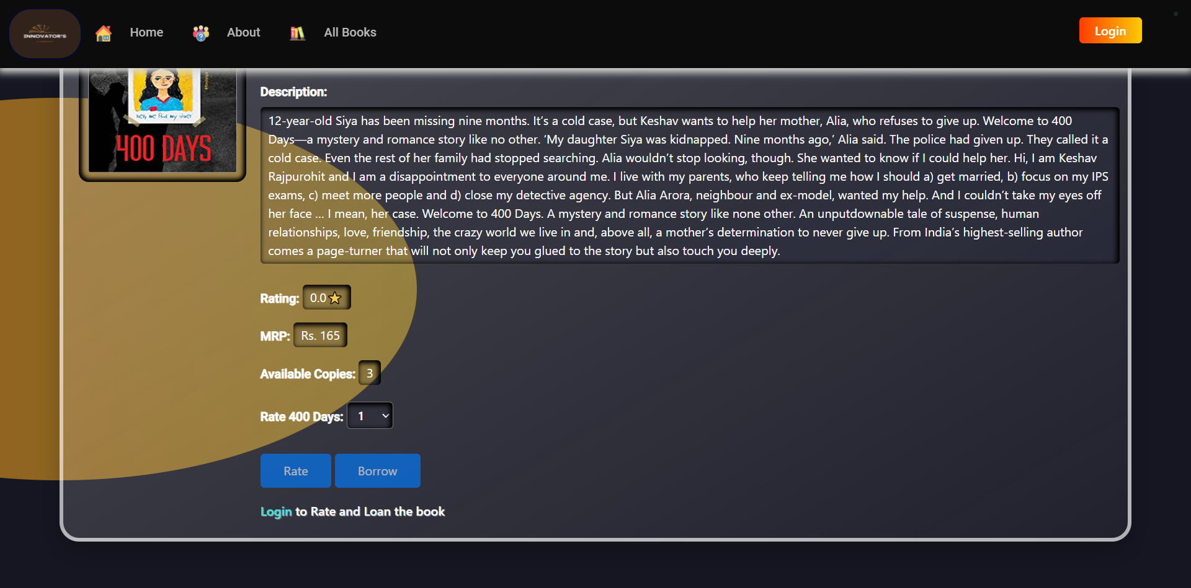
Book Detail Page(contd.)
“Before Login”

Slide 34
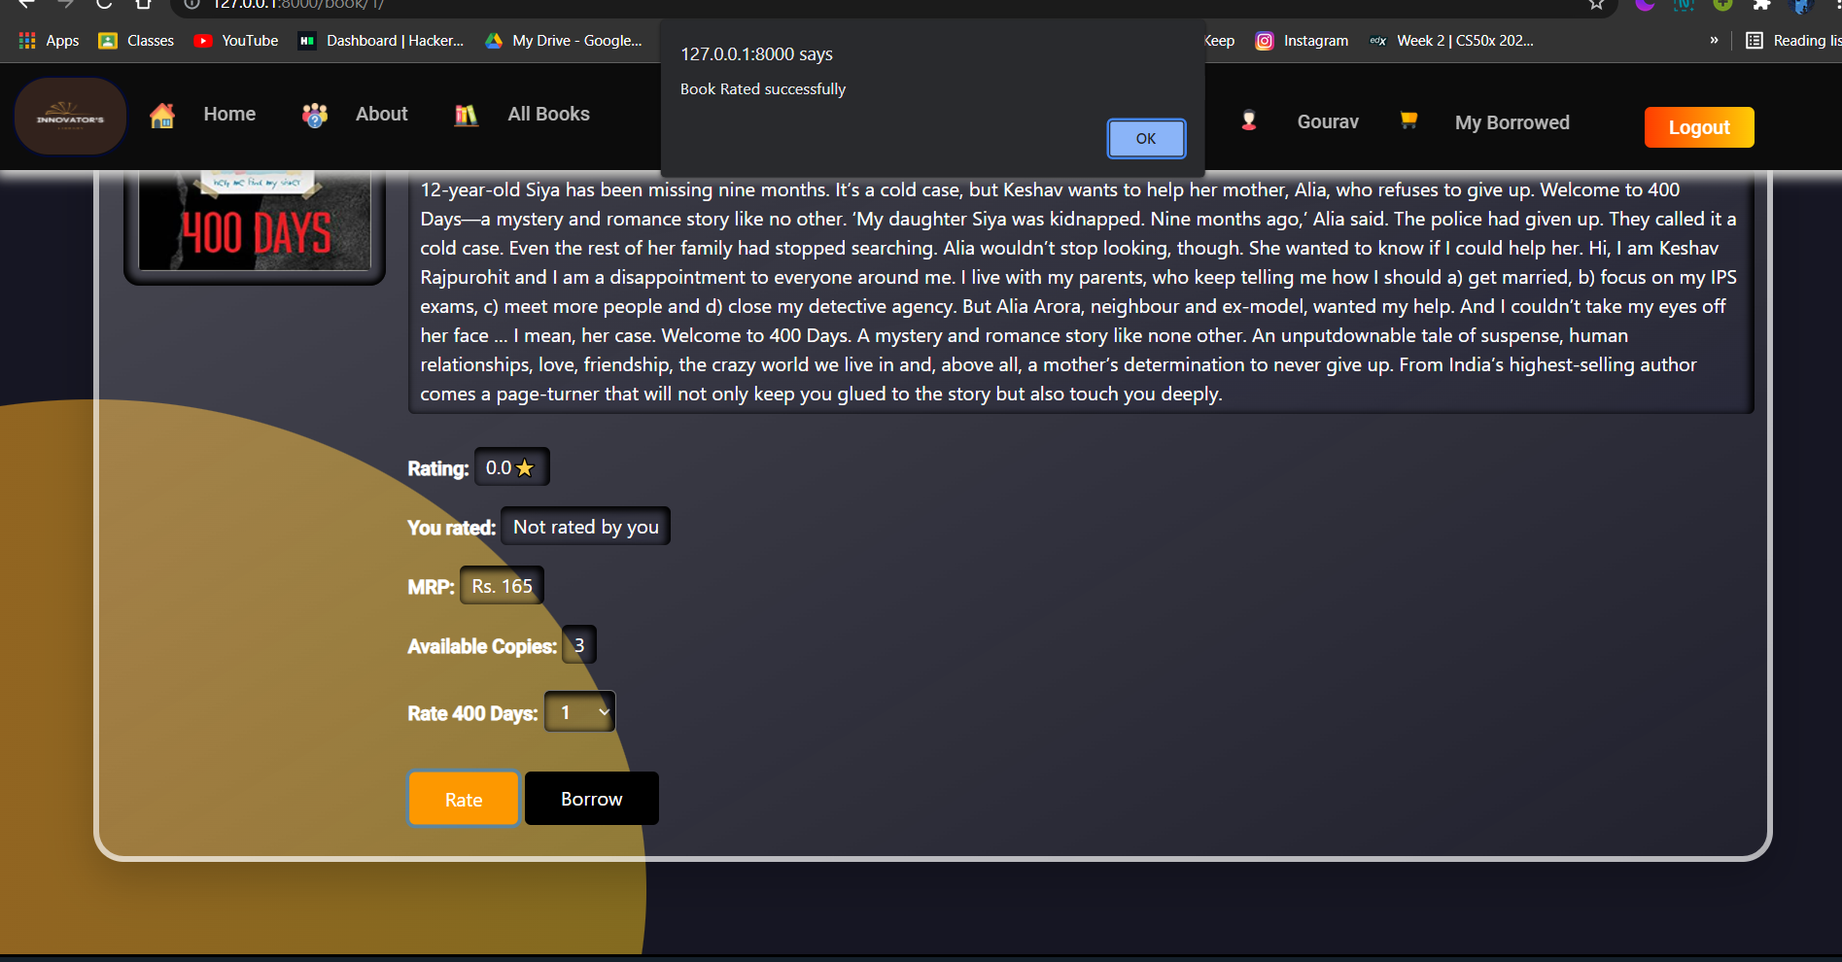
Book Detail Page(contd.)
“On rating”

Slide 35
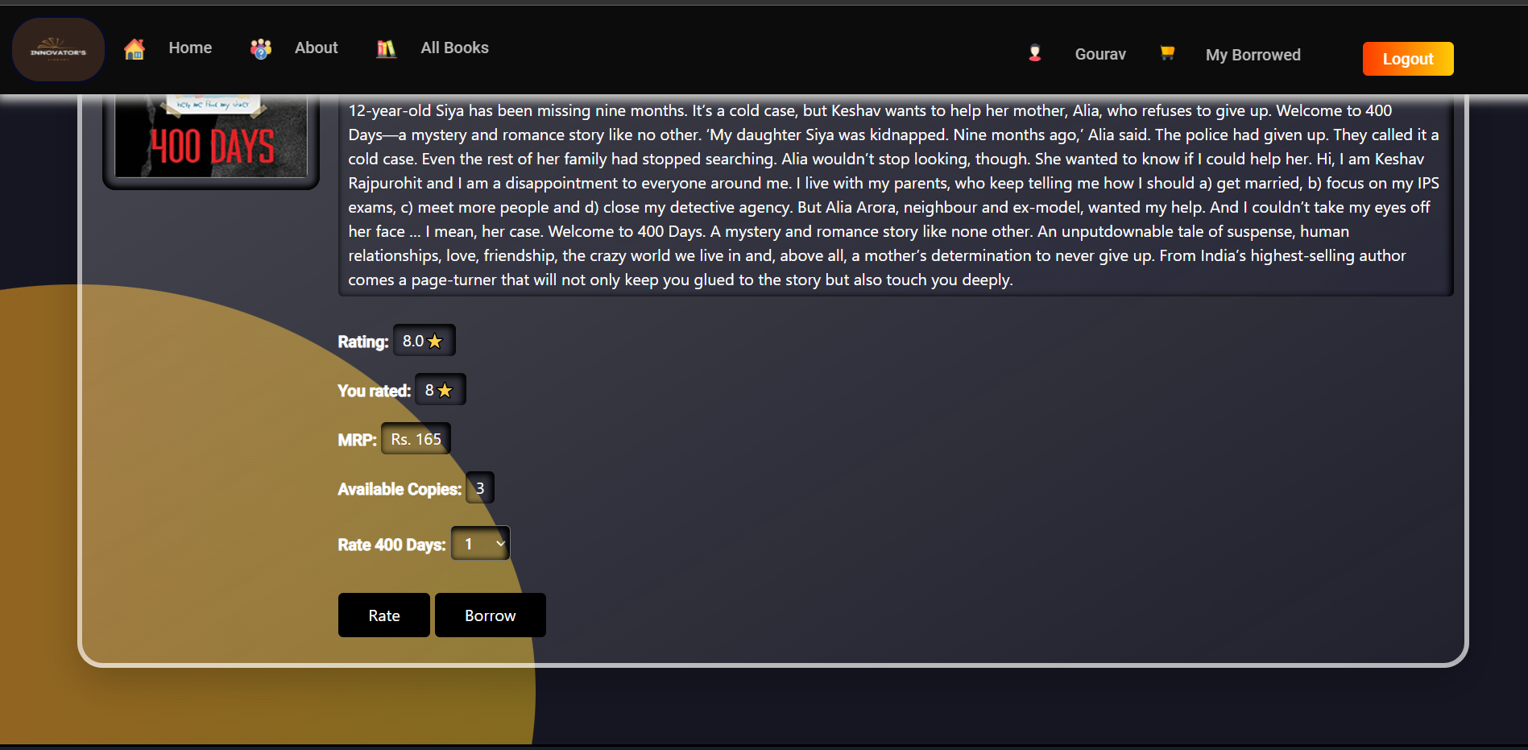
Book Detail Page(contd.)
“Your Rating appears here”

Slide 36
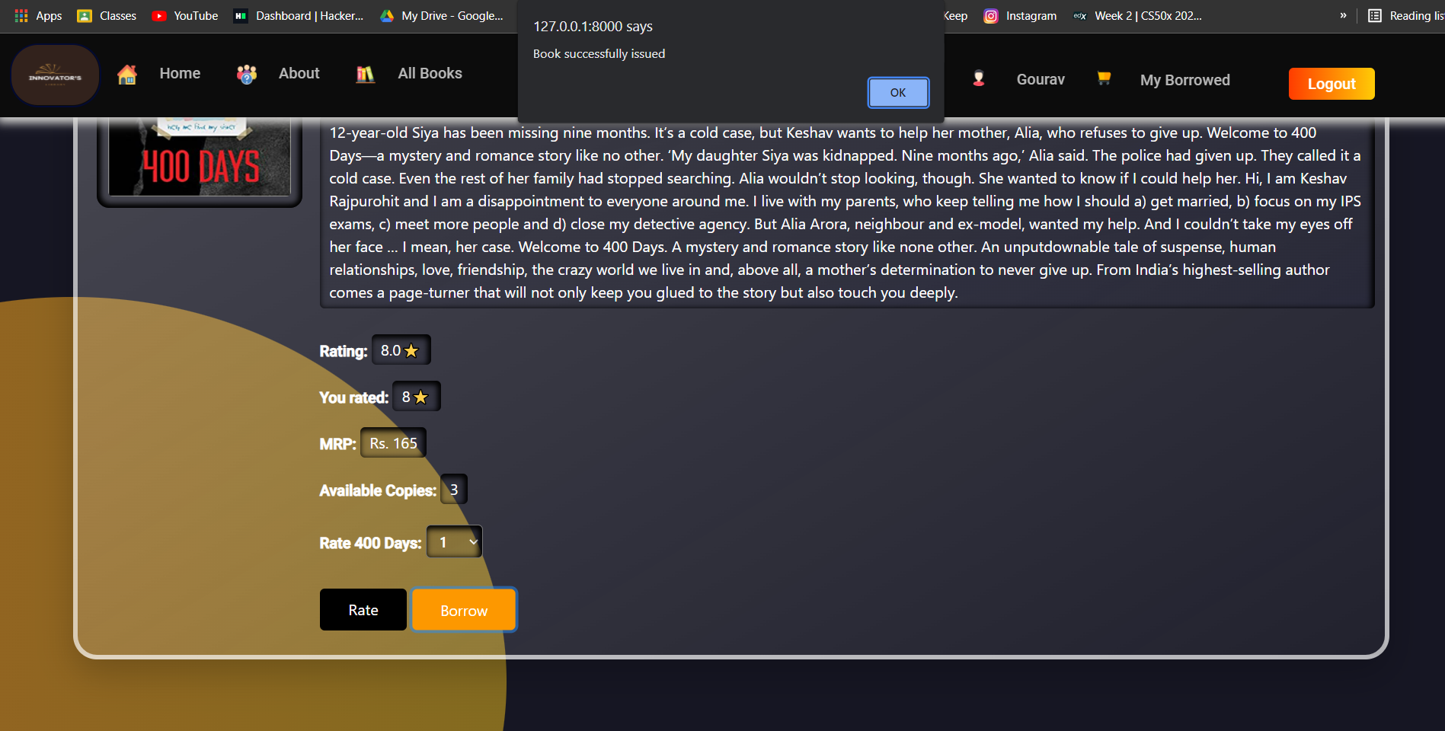
Book Detail Page(contd.)
“On Borrowing”

Slide 37
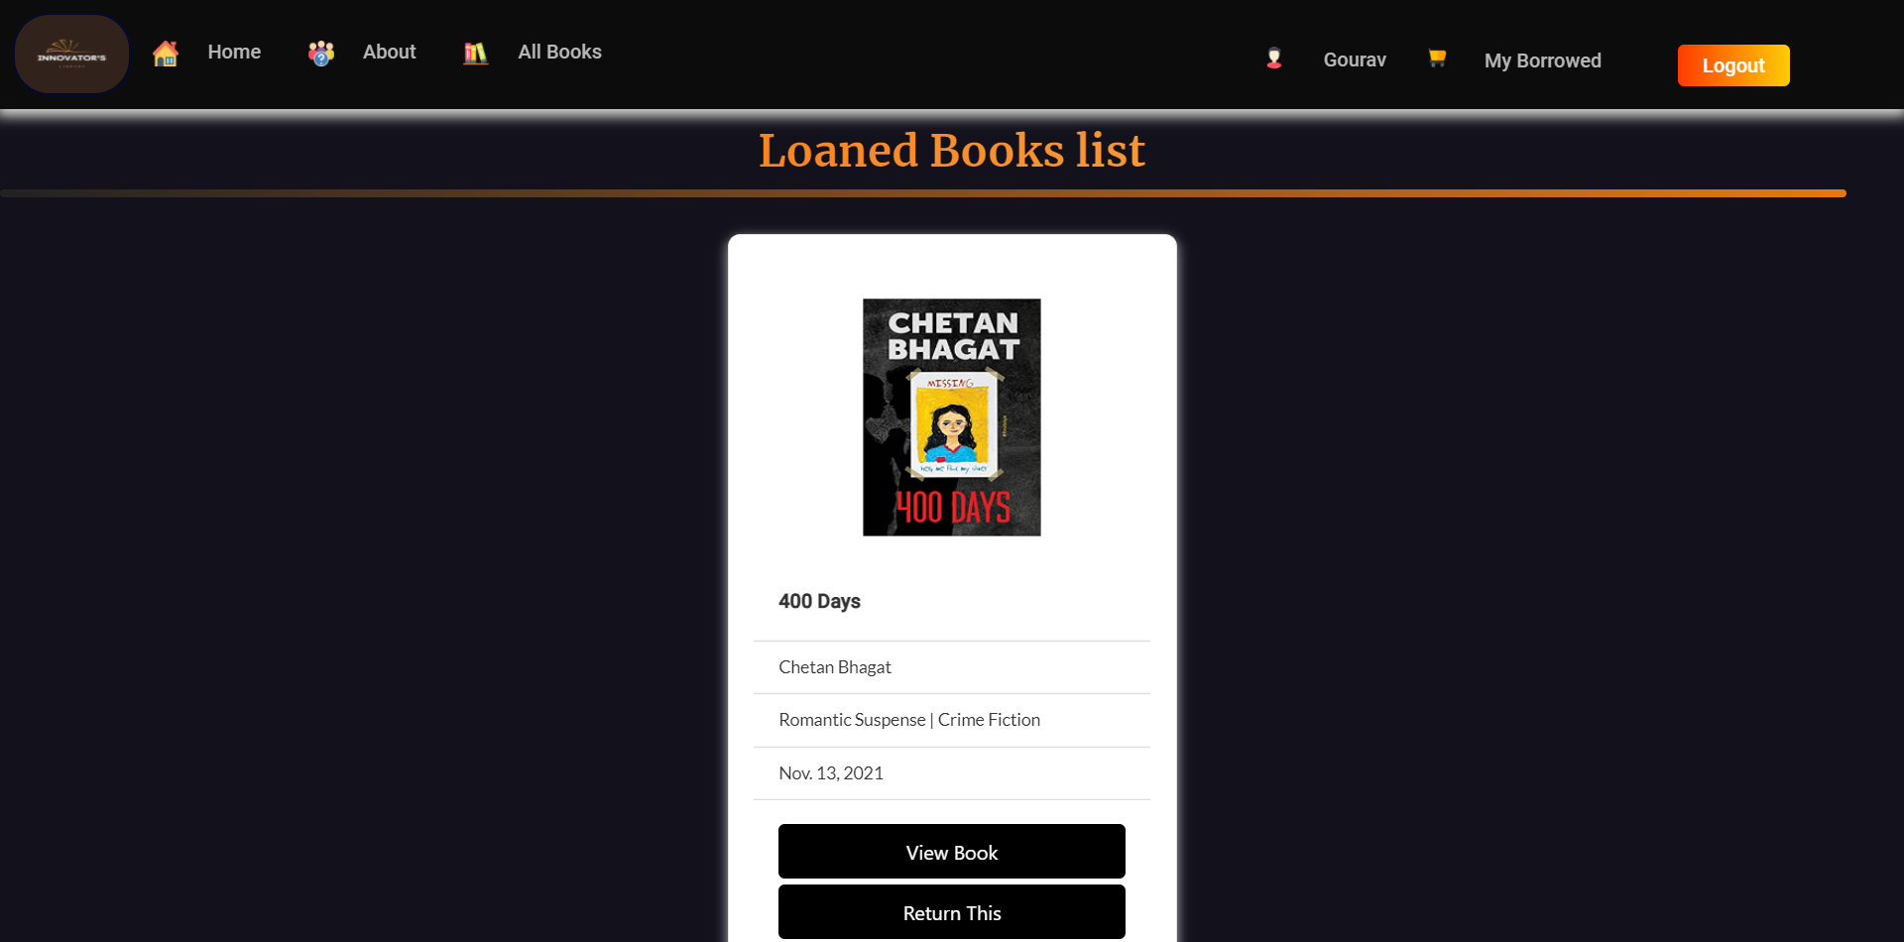
My Borrowed Page

Slide 38
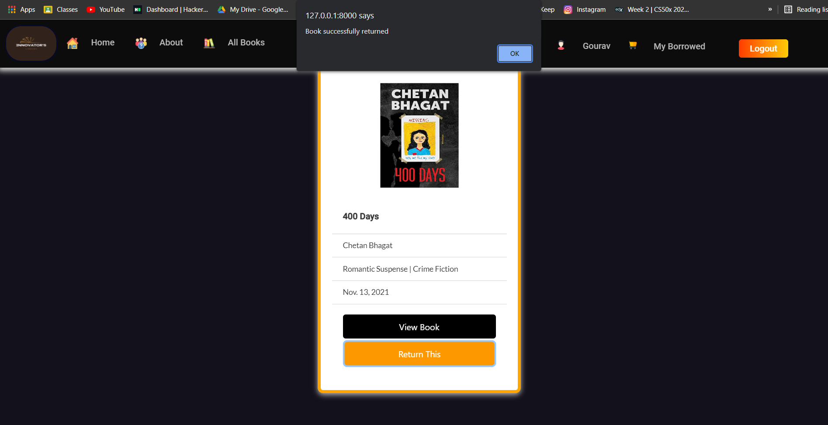
My Borrowed Page(contd.)
“On Returning”

Slide 39
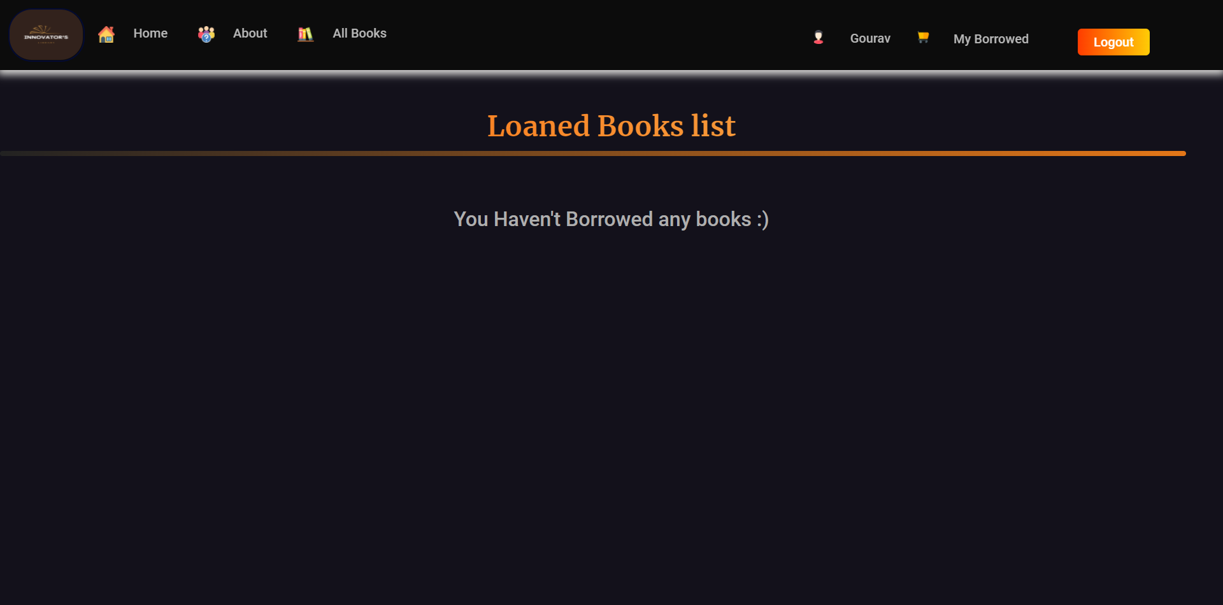
My Borrowed Page( if no book is borrowed )

Slide 40
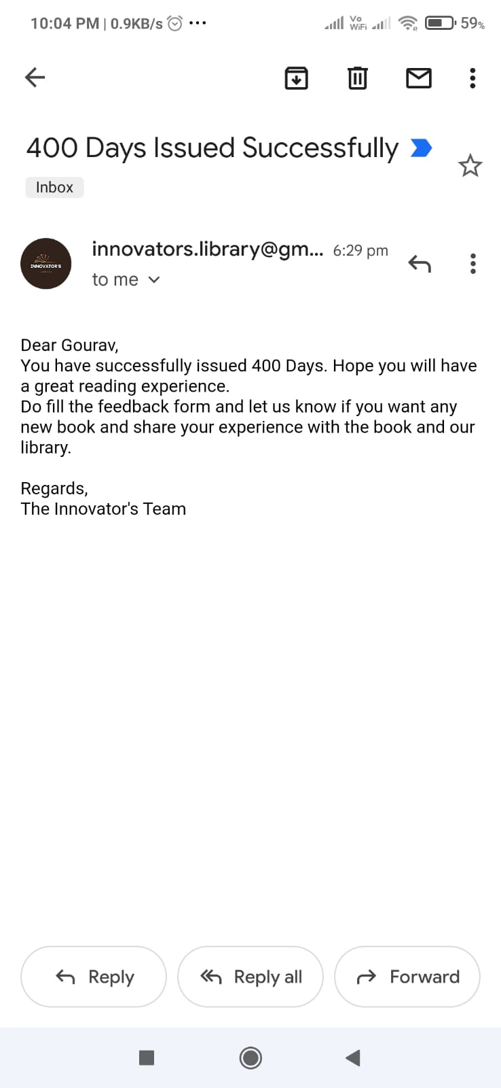
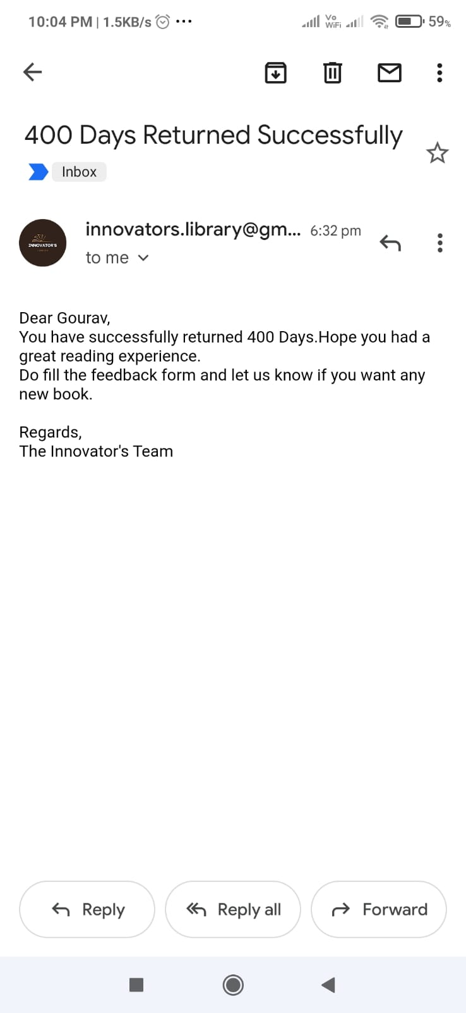
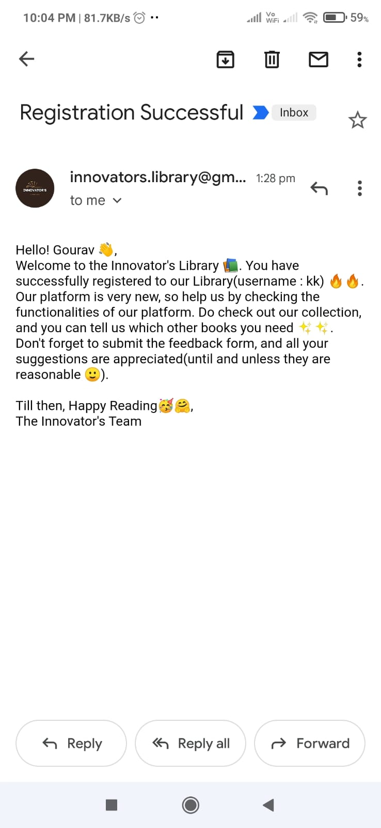
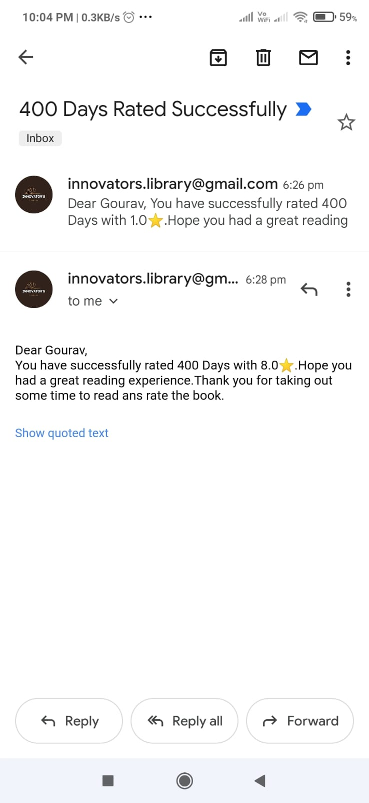
Email For Every Action

Slide 41
THANK YOU
Presented By:
Mihir Kumar Badkur(20075108)
Gourav Kumar(20074014)

